Slide 1

DSA PROJECT
SEAT ALLOTMENT SYSTEM (ALLOCER)

Slide 2

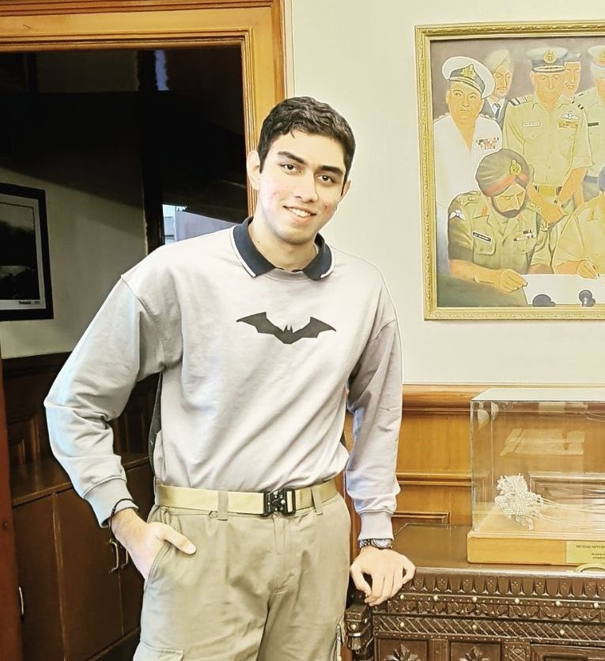

Our team
SAHIL ADHIKARI
ccccccc
ADITYA VERMA
ADITYA KHICHI
<

Slide 3
Contents
Here’s what you’ll find in this presentation
INTRODUCTION TO PROBLEM STATEMENT
OBJECTIVE
OUR SOLUTION
SYSTEM REQUIREMENTS
GUI REPRESENATAION
DSA INVOLVED IN PPT
SOURCE CODE
OUTPUT SNIPPETS

Slide 4
INTRODUCTION
01
You can enter a subtitle here if you need it

Slide 5

Introduction to problem statement!
Developing an Advanced Admission Simulation System for State Engineering Colleges: Solving Complex Allocation Challenges. This project focuses on creating a comprehensive merit-based admission system for engineering colleges.
It simulates the admission process using SRMJEE scores and course preferences. The system is modular, with distinct classes for menu, database, and allotment mechanisms.
It serves both administrators and students, offering a range of functionalities with robust input validation. The system efficiently allocates seats for over 500 students and ensures data security by encrypting passwords using a Caesar-cipher algorithm.

Slide 6





Python
Flask
Pandas
Pywebio
TECH STACK
01
02
03
04

Slide 7
OBJECTIVES
02
You can enter a subtitle here if you need it

Slide 8
OBJECTIVE!
This project endeavours to create an objective and efficient system that replicates the admission process for state-level Engineering Colleges.
It enables students to apply for engineering degree programs based on merit, considering their SRMJEE scores and course preferences. The project is structured into distinct classes such as menu, database, and allotment mechanism, each serving specific functions.
It caters to both administrators and students, offering various features while incorporating robust input validations to ensure a seamless user experience. The system adeptly allocates seats for over 500 student records in the database, enhancing security through password encryption using a Caesar-cipher algorithm.

Slide 9
OUR SOLUTION
03
You can enter a subtitle here if you need it

Slide 10
OUR SOLUTION
Our solution is an Engineering College admission simulation system called Allot Easy. It's merit-based and considers SRMJEE scores and course preferences.
The code is organized into classes for menus, databases, and allotment mechanisms. It offers distinct functionalities for admins and students, with input validations for error prevention.
The system efficiently allocates seats for over 500 student records, and passwords are encrypted for security using a Caesar-cipher algorithm.

Slide 11
Architecture Diagram
ENTER MARKS DETAILS
CHECK APPLICATION STATUS
Student
Sign Up -Login
Start Website
RUN ALLOCATION
Admin Login
OTHER FEATURES

Slide 12
DSA Concept Used
Linear Search
Pandas – linear search algorithm
Sorting Algorithm
Pandas – Sorting students based on marks, tabular data structure
List Arrays
List arrays to store student data

Slide 13
CODE SNIPPT
04
You can enter a subtitle here if you need it

Slide 14
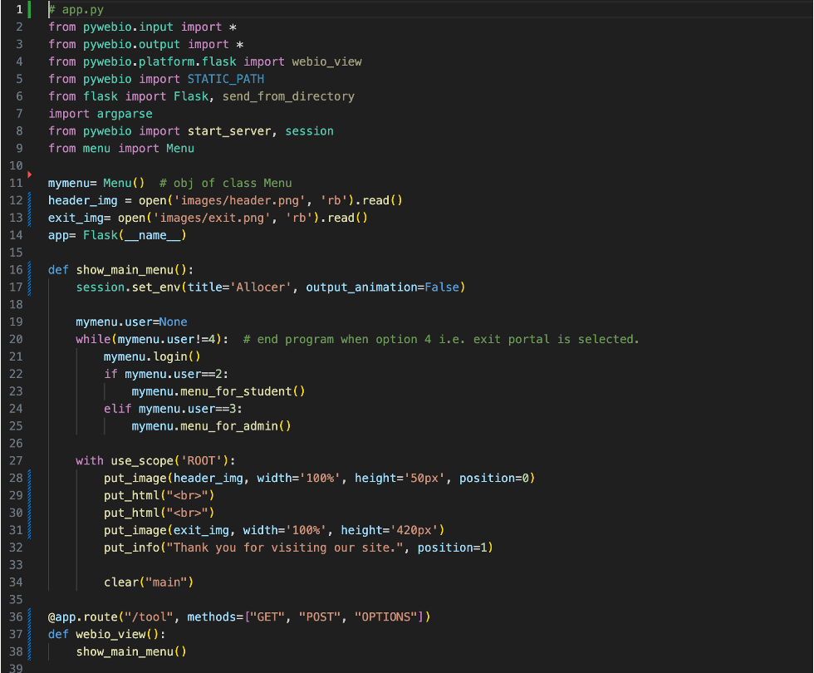
APP.PY

Slide 15
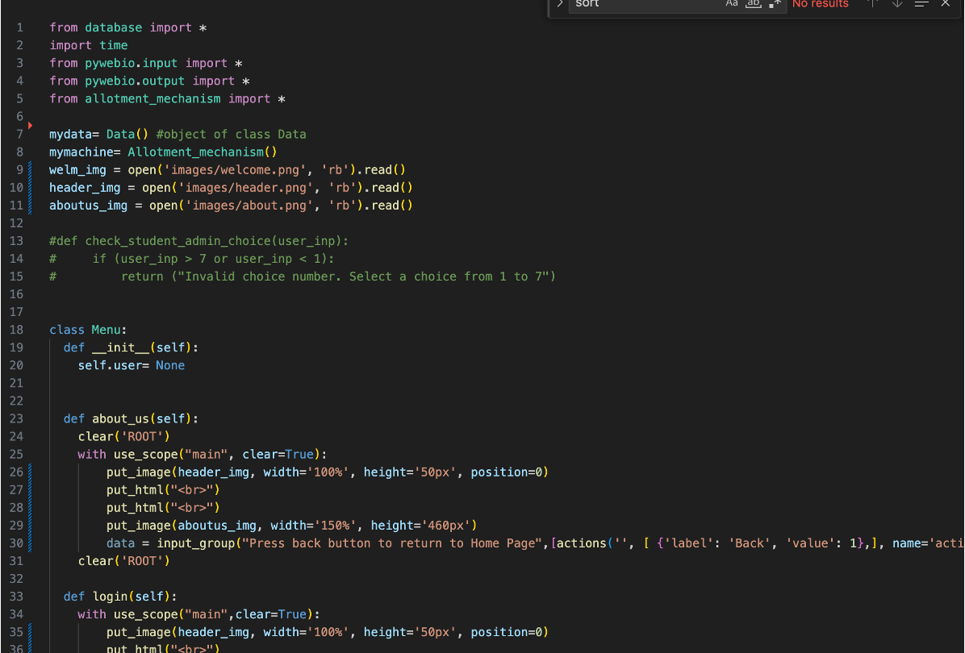
MENU.PY

Slide 16
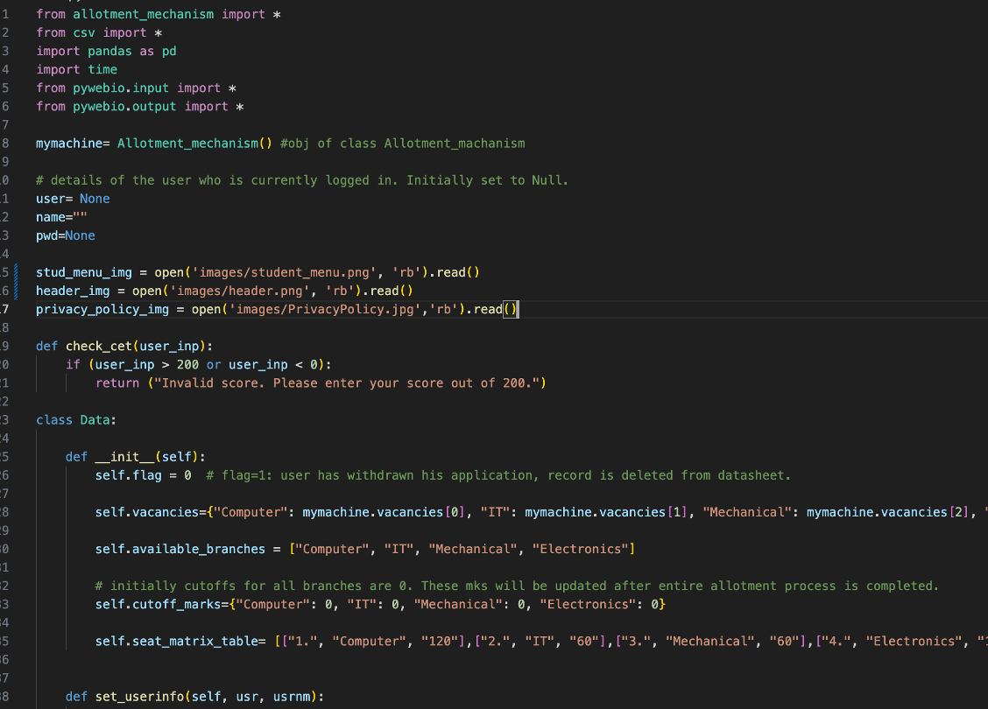
DATABASE.PY

Slide 17
OUTPUTS
05
You can enter a subtitle here if you need it

Slide 18
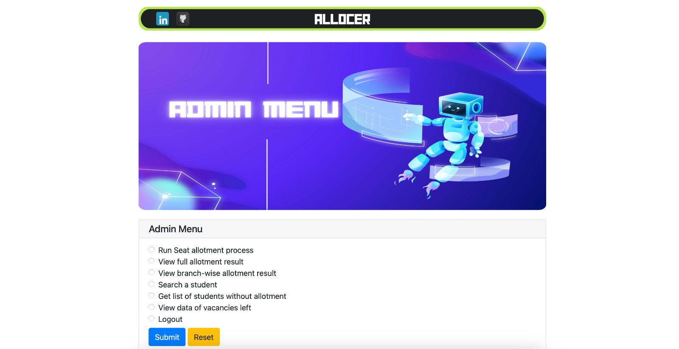
ADMIN MENU

Slide 19
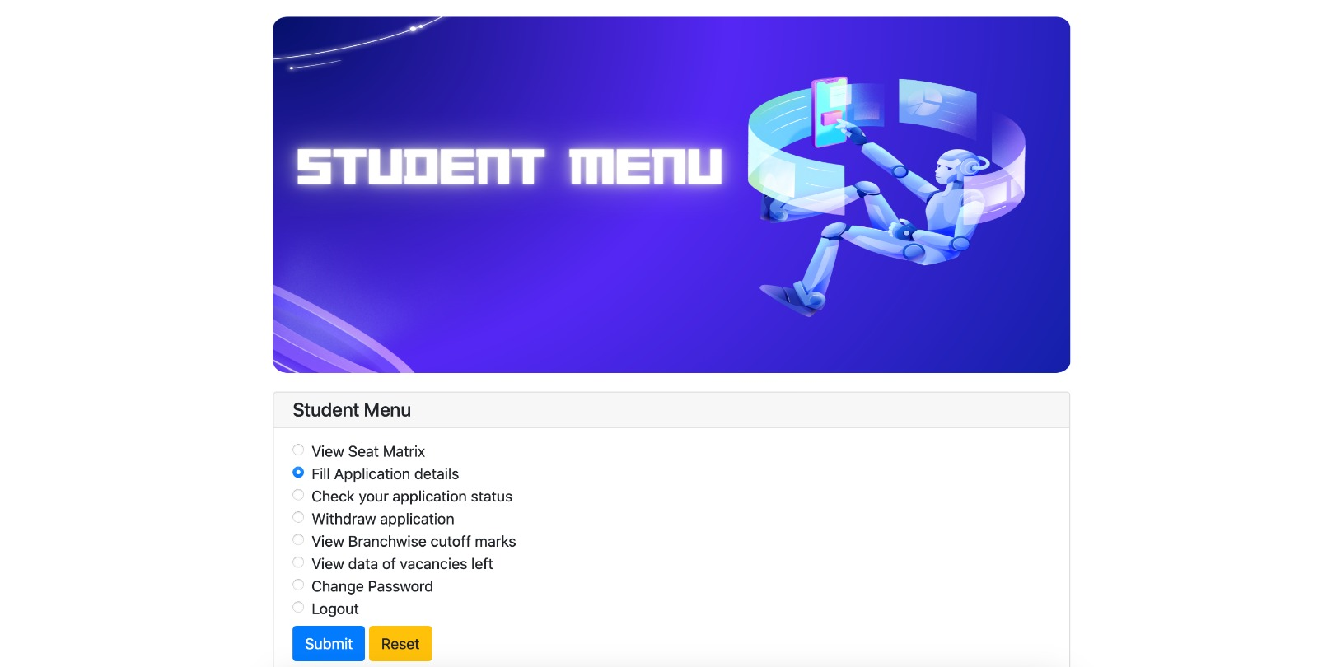
STUDENT MENU

Slide 20
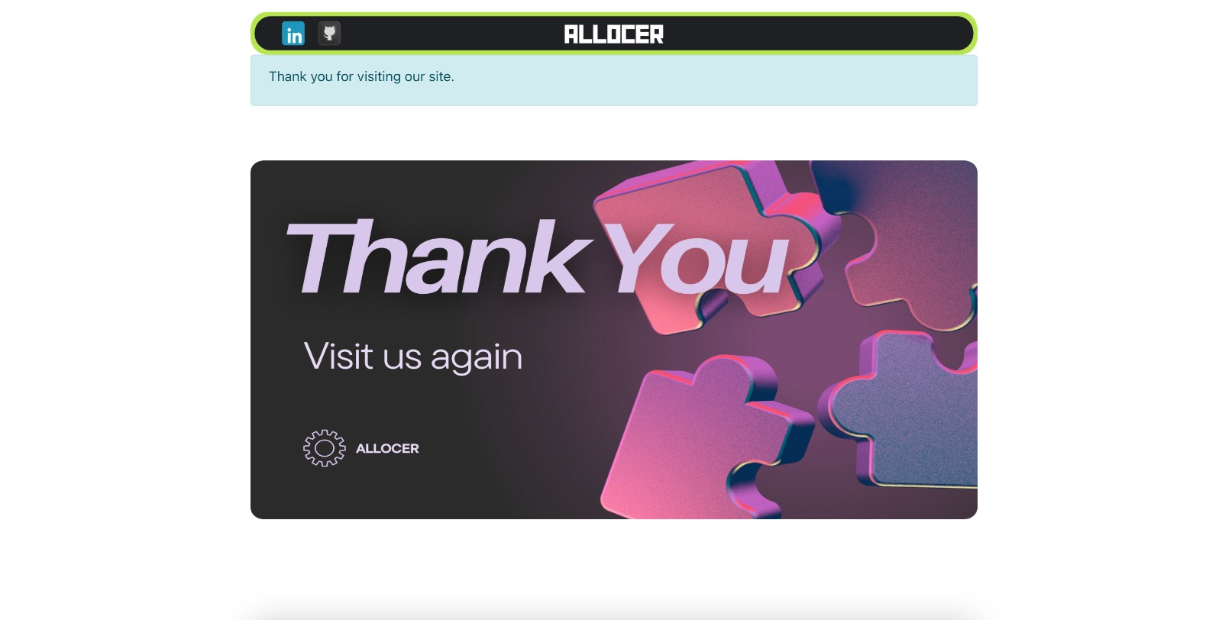
EXIT PAGE

Slide 21

Thanks!
v

